Slide 1







Chapter: 1
Portfolio Project Making HTML CSS

Slide 2
Problem Statement
In today’s competitive digital landscape, establishing a professional online presence is crucial for showcasing skills and attracting potential clients or employers.
“
“

Slide 3
Abstract
The portfolio project aims to create a visually appealing and functional online platform using HTML and CSS to showcase skills in web development and design. It seeks to provide a professional presentation of projects, expertise, and accomplishments, tailored to attract potential clients or employers. The project will focus on responsive design principles, usability, and aesthetic appeal to effectively communicate proficiency in HTML and CSS while demonstrating creativity and attention to detail.
“
“

Slide 4
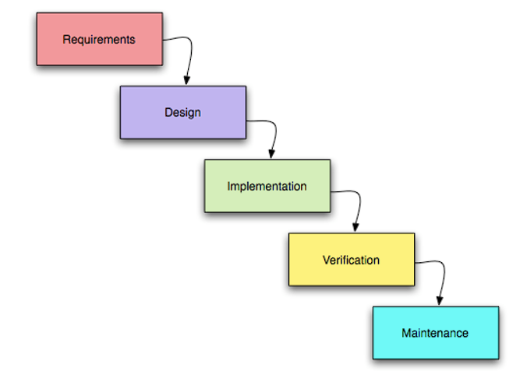
Development Model & Tools Technology
TOOLS
1.GitHub
2.Visual Studio Code
3.HTML
4.CSS

Slide 5
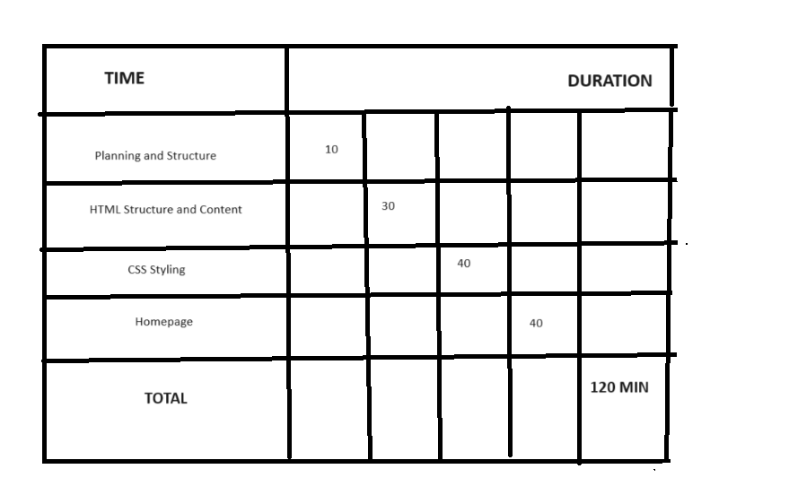
TimeLine Chart

Slide 6
Project Structure
index.html
This file serves as the landing page or homepage of your portfolio.
Include a brief introduction, links to other sections (About Me, Portfolio, Contact), and key highlights.
about.html
This page provides detailed information about yourself.
Include a biography, skills, education, and any other relevant details.
portfolio.html
Showcase your projects on this page.
Each project can have a brief description, images/screenshots, and links to live demos or GitHub repositories.
contact.html
This page allows visitors to get in touch with you.
Include a contact form (if possible) or provide contact information such as email address, social media links, etc.
style.css
Central stylesheet that defines the visual appearance and layout of all HTML pages.
Include styles for typography, colors, layout positioning, responsiveness (using media queries), and any animations or transitions.
Notes:
6

Slide 7
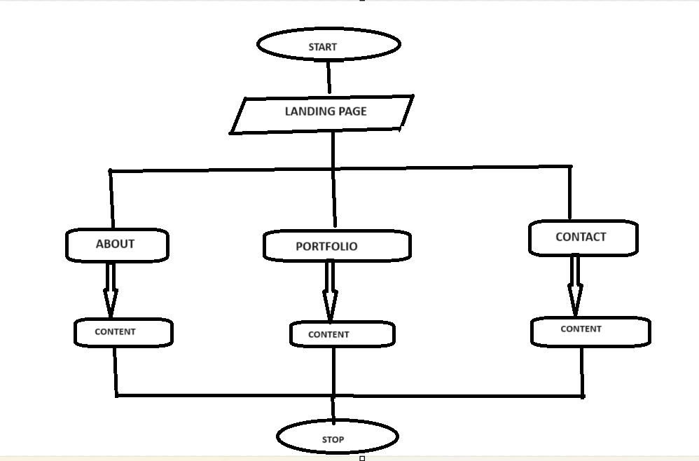
FlowChart-Portfolio
Notes:
7

Slide 8
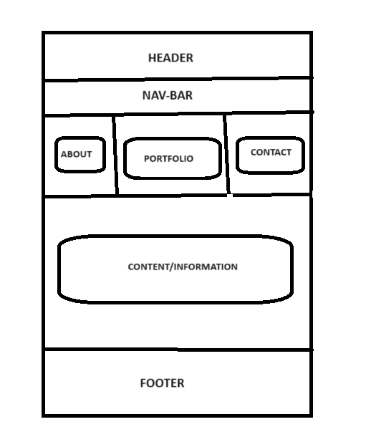
WireFrame-Portfolio
LOGO
Notes:
8

Slide 9
CODE
ABOUT HTML PAGE
CONTACT HTML PAGE
PORTFOLIO HTML PAGE
INDEX HTML PAGE
STYLE CSS PAGE
Notes:
9

Slide 10
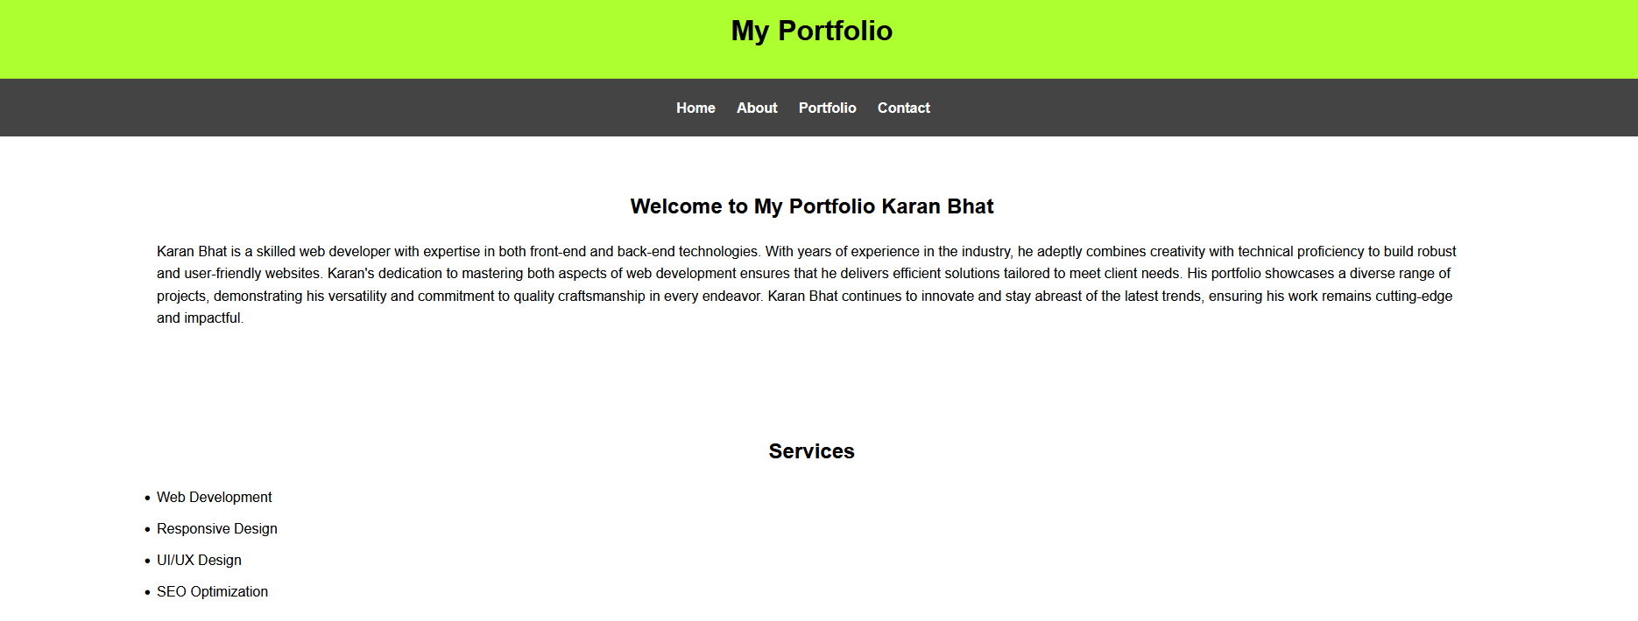
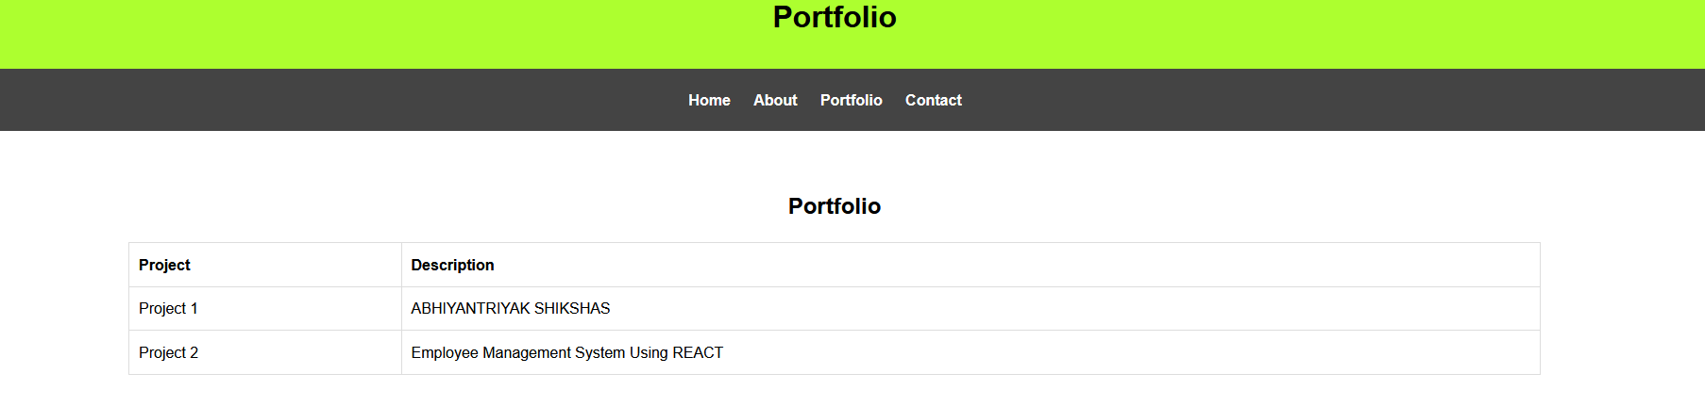
Output Snapshot
Notes:
10

Slide 11
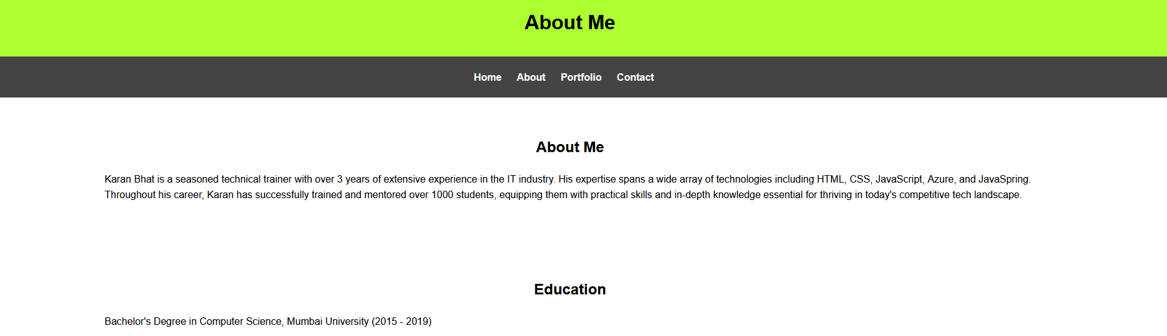
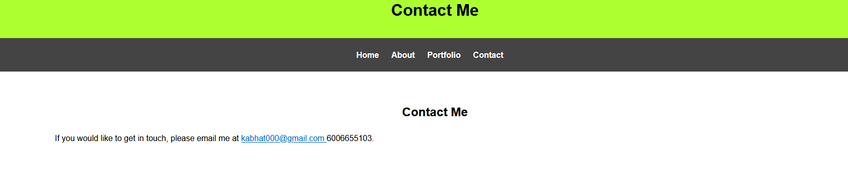
Output Snapshot
Notes:
11

Slide 12
Thank you!
Notes:
12

